Slide 1
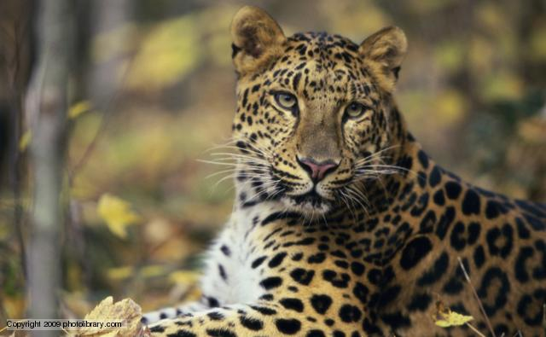
Leopard News
2017-2018 School Year
Nov 13-17

Slide 2

Sports- Volleyball
Congrats to the Lady Leopard’s Volleyball teams for a great season.

Slide 3
Staff vs. Student Volleyball
Tickets to the game will go on sale Monday, Nov 13th
$2 for General Admission
$5 for VIP, includes hot dog, chips and a drink
Tickets will be sold during lunch time, space is limited!!!!

Slide 4

Sports- Football
Congrats to the Leopard’s Football teams for a great season.

Slide 5
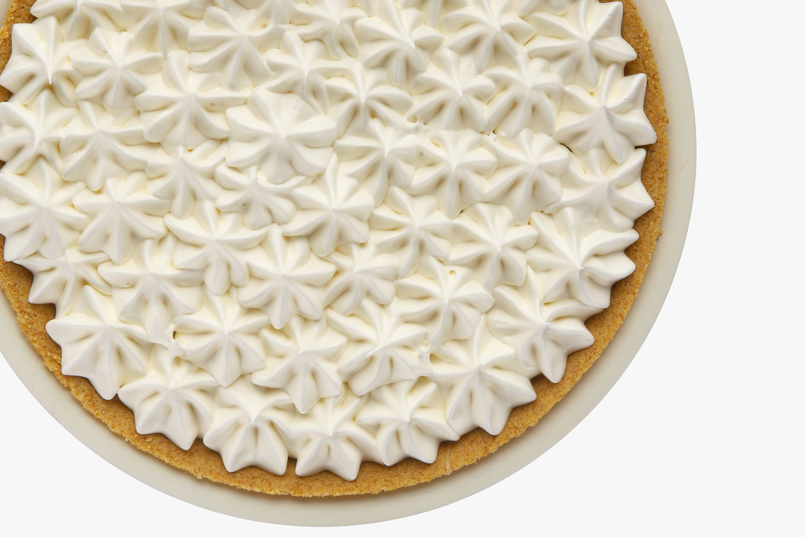
United Way:
The “Pie in the Face” competition is underway.
Feel free to contribute your donations to the Assistant Principal that you would most like to see get a pie in the face.

Slide 6
Coding Club:
There will be a coding club meeting this Thursday, Nov 16th starting at 3:15pm in room 501.

Slide 7
Rubik’s Cube Wannabe’s:
During the month of November, Mrs. Cox will be hosting a get together to work on how to solve the Rubik’s Cube.
During 7th grade lunch, grab your lunch and go to room 618
Tournament will be held at the end of the month.

Slide 8
Chess Club:
This week’s meetings are canceled and will start the Monday, Nov 27th.
If you are interested in playing chess, the meetings will be Mondays and Fridays from 3:05 to 4pm.
If you have any questions, please see Mr. Cranford in room 713

Slide 9
Student Council:
Interested in an opportunity to develop leadership qualities by organizing and carrying out school activities and service projects?
Student council maybe the right club for you!
see Ms. Brown or Mr. Fulcher

Slide 10
Theatre Club:
Do you love to perform?
Maybe you want to learn?
Come join the Leopards Theatre Club, if you have questions, please see Mr. Glynn in room 706

Slide 11
Photography Club:
Want to learn and try different techniques?
Want to share photos?
Hang out with other photography lovers, on Fridays from 3:10 to 3:55pm in room 408, starting Friday, Nov 17th.
See Mrs. Stack for more information.

Slide 12
Upcoming Events:
Tuesday: Picture Re-Takes for anyone who was not able to get their pictures taken in October
Fall Middle School Dance Showcase: Good Luck to the Showstoppers Dance Team!!!

Slide 13
Upcoming Events:
Wednesday: Educational Support Staff Day, help us thank all of our aids for all their hard work in making sure that our Smith Leopards are successful.
Thursday: Rhett Revolution Field Trip, remember to wear your SMS shirts!!!

Slide 14
Upcoming Events:
Thanksgiving Break: Nov 20th – 24th, No School!!

Slide 15
IDs:
Students your ID must be worn around your neck with the appropriate colored lanyard.
  6th grade- Yellow
  7th grade- Red
  8th grade- Green
If you lose your ID you can purchase a replacement for $5.

Slide 16
Announcements-
Students remember to wear your IDs and make sure that they are out and visible at all times.
Students remember that backpacks are not allowed in the classrooms.

Slide 17
Announcements-
Students check the lost and found located on the ramp to the stage.

